Slide 1
CASE STUDY
AT A GLANCE
Bright Motors
559K
$8B
Car Sales Analysis
Total cars sold
Total revenue
38
57
Business insights for the new Head of Sales
Regions covered
Distinct car makes
Prepared by: Thulasizwe Buthelezi
Dataset: Bright Car Sales
A data-driven roadmap to grow the dealership network,
lift sales performance and optimise inventory.

Slide 2
CONTENTS
Agenda
01
Background
About Bright Motors and the analysis brief
02
Objectives & approach
What the new Head of Sales needs to know
03
Sales channels & product mix
Headline KPIs from the dashboard
04
WHERE — regional performance
Top revenue and sales states
05
WHAT — winning makes, models & body types
Where the money comes from
06
WHO — customer preferences
Colour, transmission and price tiers
07
HOW — price, mileage & condition
Relationship across pricing levers
08
WHEN — timing of sales
Month, day and time-of-day patterns
09
WHY — emerging trends
Manufacturing year & seller channel
10
Recommendations & next steps
Actions to grow profitability
Bright Motors | Car Sales Analysis
2 / 13

Slide 3
BACKGROUND
About Bright Motors
• Bright Motors is a multi-region car dealership selling new and used vehicles across 38 regions.
• A new Head of Sales has been appointed with a mandate to expand the dealership network, lift sales performance and optimise inventory.
• The Bright Car Sales dataset captures daily transactional and pricing data across 559,000 vehicle sales.
• This presentation translates that historical data into actionable insights to guide future sales and marketing strategy.
DATASET SNAPSHOT
559K
$8B
Transactions
Revenue
57
852
Makes
Models
38
14K
Regions
Sellers
Bright Motors | Car Sales Analysis
3 / 13

Slide 4
OBJECTIVES
What we set out to answer
WHAT
Which makes, models & body types generate the most revenue?
WHERE
Which regions deliver the highest sales volume and revenue?
HOW
How are price, mileage and year of manufacture related?
WHEN
What seasonal and weekly patterns drive sales timing?
WHY
What emerging customer preferences should we lean into?
Bright Motors | Car Sales Analysis
4 / 13

Slide 5
HEADLINE KPIS
Sales channels & product mix
INSIGHT
• 559K transactions and $8B in revenue across 38 regions confirm strong national reach.
• A wide catalogue (57 makes, 852 models, 46 body types) means inventory complexity — a chance to rationalize the long tail.
• Customer preference is concentrated: only 21 colors, 18 interiors and 3 transmission types do all the work.
• 14K sellers participated; the top 10 sellers generate a disproportionate share
Bright Motors | Car Sales Analysis
5 / 13

Slide 6
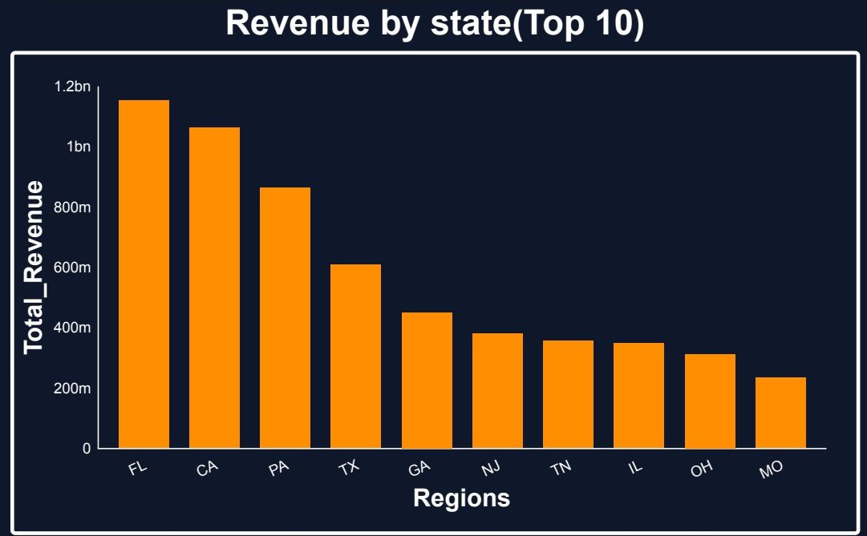
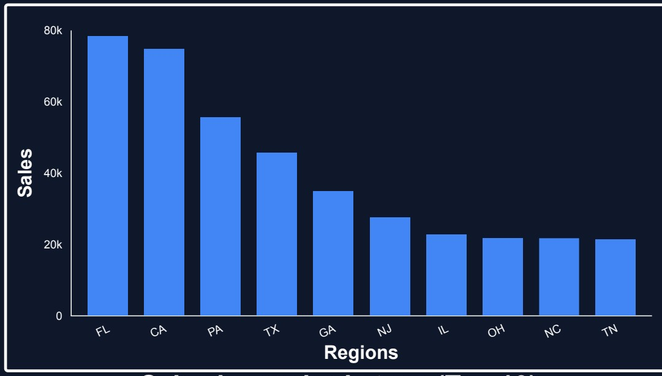
WHERE
Regional performance — top revenue & sales states
Revenue by state (Top 10)
Sales volume by region (Top 10)
KEY TAKEAWAY
• Florida and California lead on both revenue (~$1.1B & $1.05B) and sales volume — anchor markets to defend.
• Pennsylvania, Texas and Georgia round out the top 5 — strong candidates for dealership expansion.
• Top 5 states drive ~50% of total revenue → opportunity to grow share in mid-tier states (NJ, IL, OH, TN).
Bright Motors | Car Sales Analysis
6 / 13

Slide 7
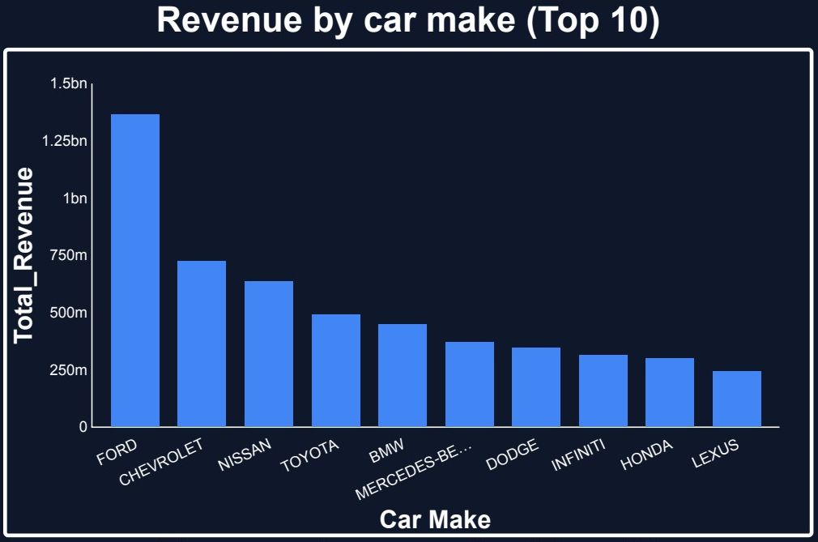
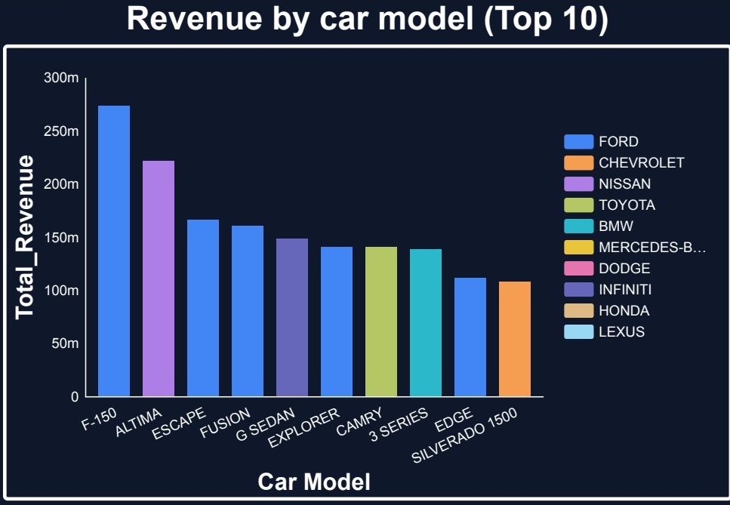
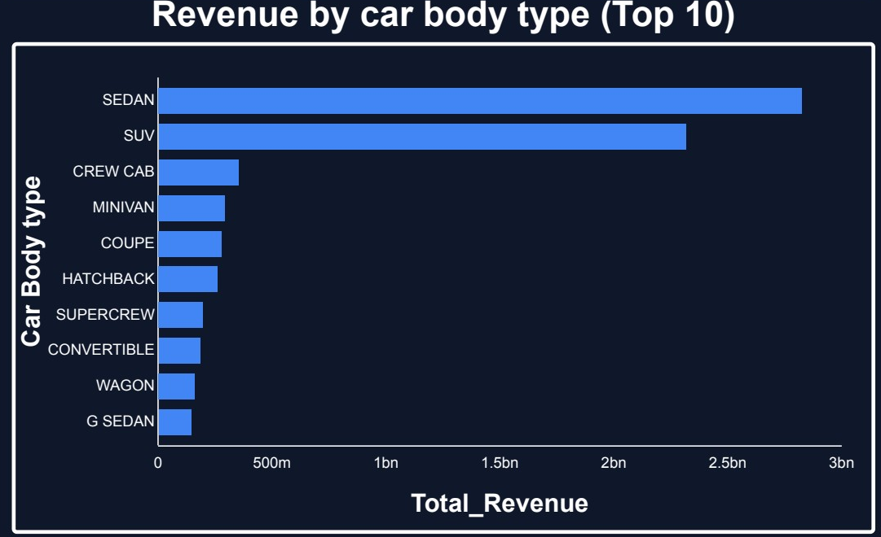
WHAT
Winning makes, models & body types
INSIGHT
• Ford alone drives ~$1.35B in revenue (almost 2× Chevrolet).
• F-150 and Altima are the top revenue-generating models.
• Sedan and SUV body types deliver ~$5.2B — about 65% of total revenue.
• The long tail of 46 body types produces minimal returns — rationalize.
Bright Motors | Car Sales Analysis
7 / 13

Slide 8
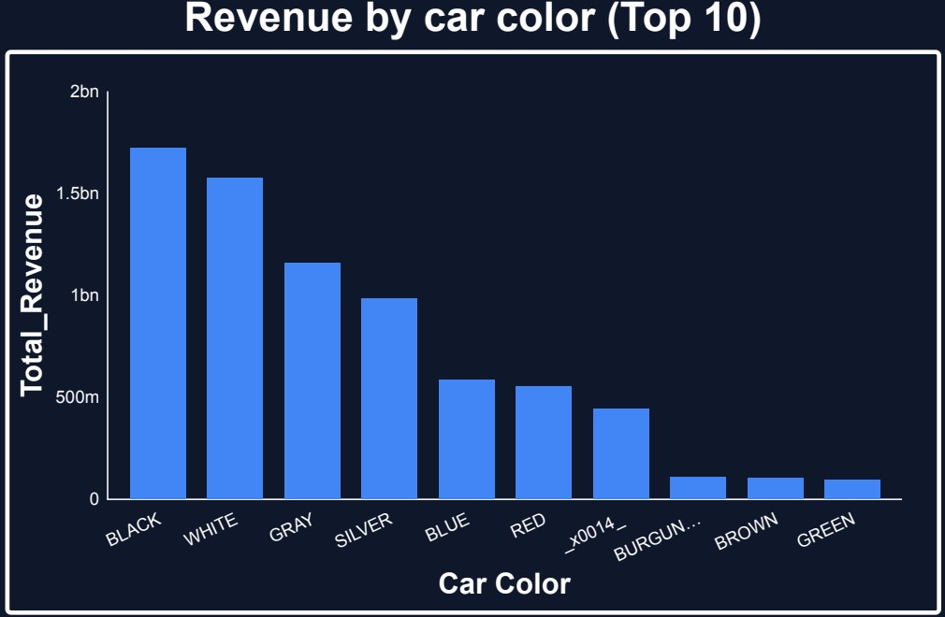
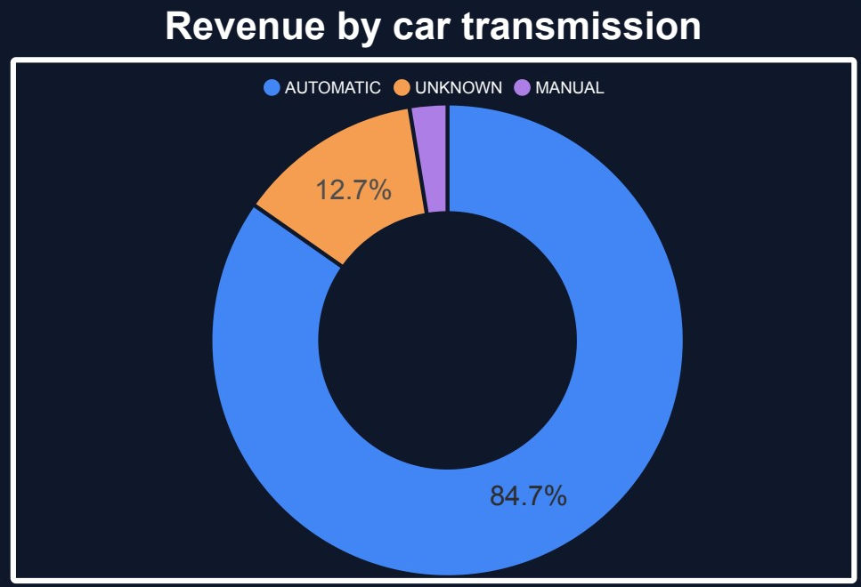
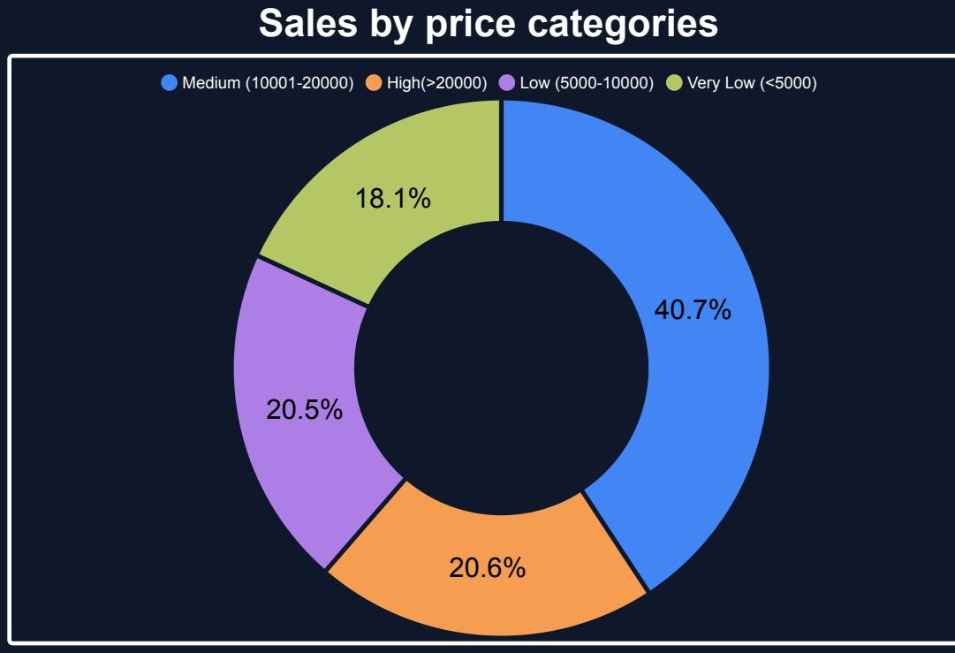
WHO
Customer preferences — colour, transmission & price
WHAT CUSTOMERS PICK
• Black, white and grey/silver vehicles drive 70%+ of revenue — stock these neutrals first.
• Automatic transmission accounts for 84.7% of revenue; manual is a niche 2.6%.
• Mid-priced cars ($10K–$20K) are the sweet spot at 40.7% of sales — premium tier ($20K+) adds another 20.6%.
Bright Motors | Car Sales Analysis
8 / 13

Slide 9
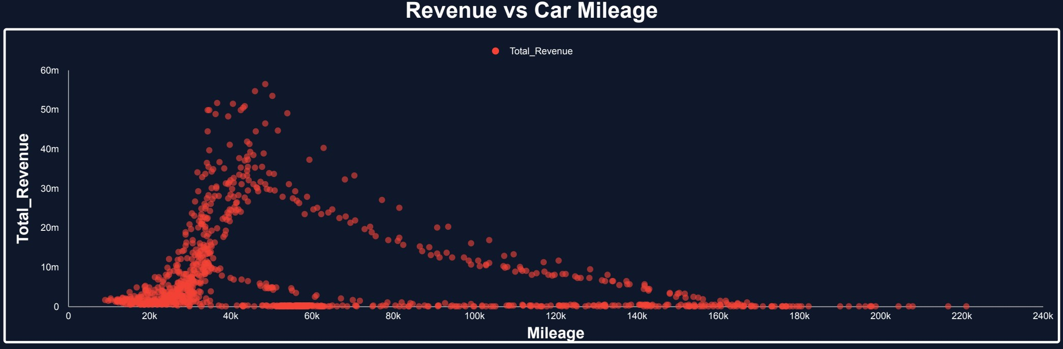
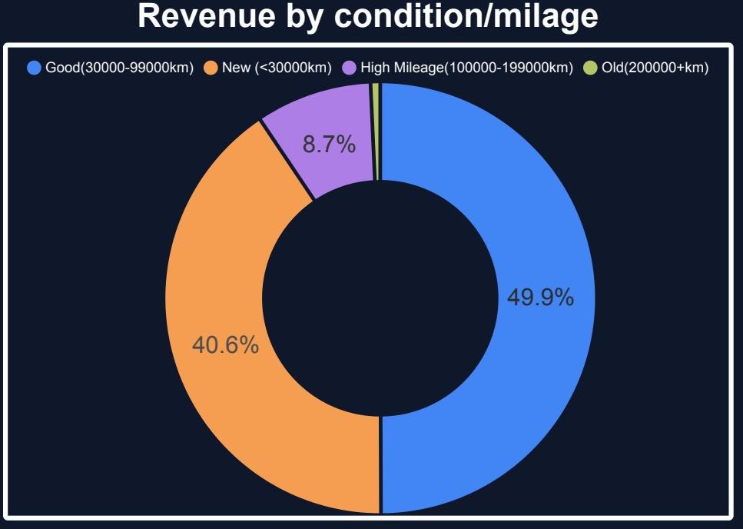
HOW
Price, mileage & condition relationship
INSIGHT
• Revenue concentrates between 20K–60K miles — the optimal mileage band for resale.
• ‘Good condition’ (30K–99K km) generates 49.9% of revenue; ‘New’ (<30K km) adds 40.6% → 90% from low-to-mid mileage stock.
• High-mileage vehicles (100K+) deliver under 10% of revenue → reduce purchase exposure on aged inventory.
Bright Motors | Car Sales Analysis
9 / 13

Slide 10
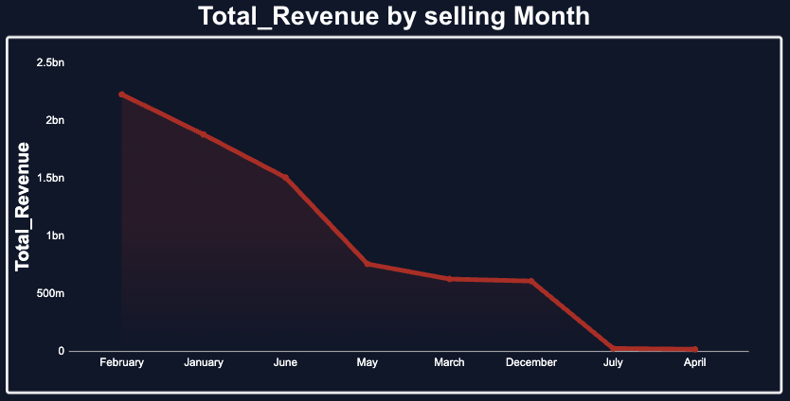
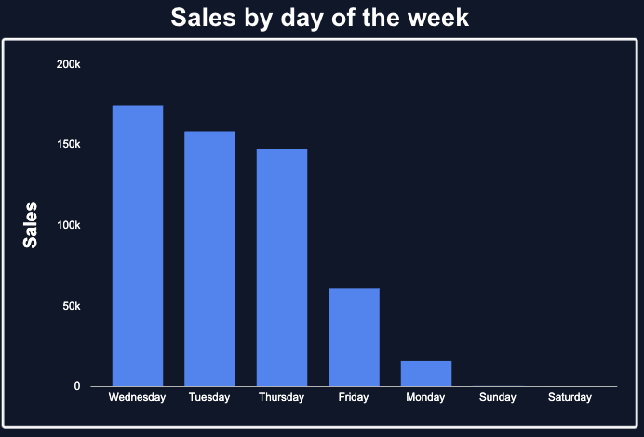
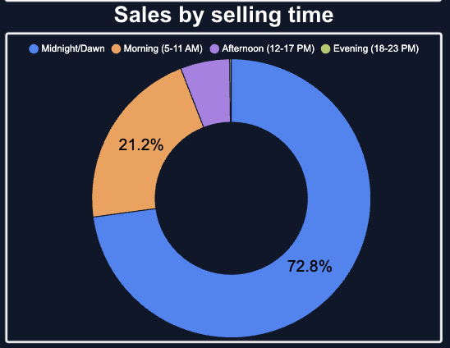
WHEN
Seasonal, weekly and time-of-day patterns
TIMING INSIGHTS
• Revenue peaks in Feb–Jan (>$2B) then falls sharply through Apr — front-load marketing in Q1.
• Wednesday → Friday account for nearly all weekly sales; weekends are dormant — staffing & promos should shift mid-week.
• 72.8% of sales close in midnight/dawn hours (auction-style flows) — invest in 24/7 listing infrastructure.
Bright Motors | Car Sales Analysis
10 / 13

Slide 11
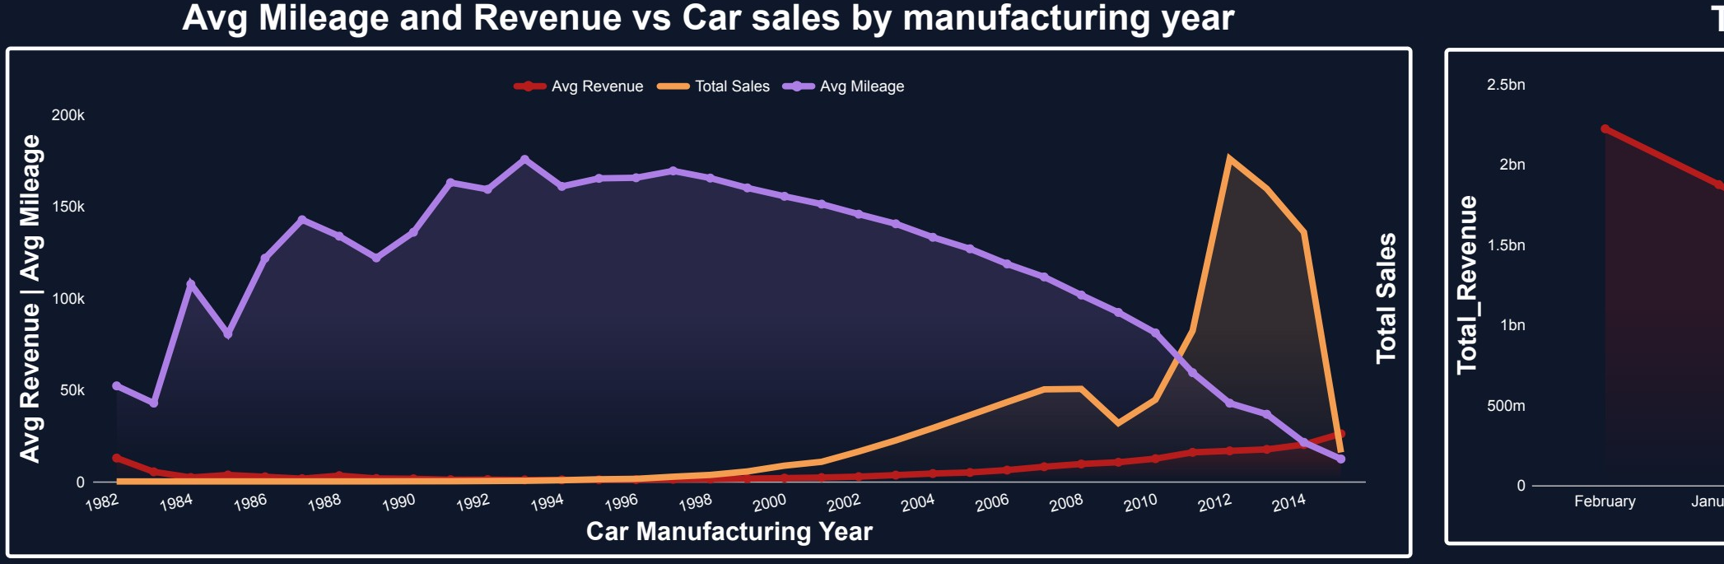
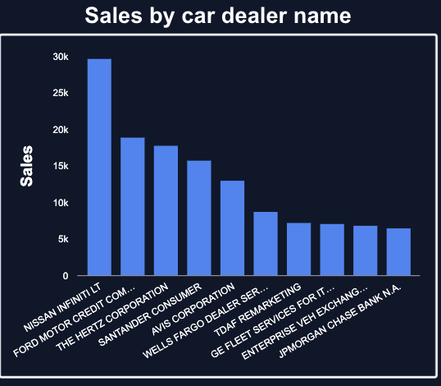
WHY
Emerging trends — manufacturing year & seller mix
TRENDS WORTH ACTING ON
• Sales of newer model years (2010+) are accelerating sharply while average mileage trends down — buyers are moving to younger stock.
• Older inventory (pre-2000, peak avg mileage ~175K km) generates very little revenue — phase out aggressive sourcing here.
• Top 10 sellers (Nissan Infiniti LT, Ford Motor Credit, Hertz, Santander, Avis) supply >130K units — deepen these partnerships and negotiate volume terms.
Bright Motors | Car Sales Analysis
11 / 13

Slide 12
RECOMMENDATIONS
How to grow profitability & efficiency
1
Expand dealership footprint
Open or franchise in PA, TX, GA, NJ — proven demand, top-10 revenue states with room to grow.
2
Rationalise inventory mix
Lead with Ford, Chevrolet, Nissan, Toyota in Sedan & SUV body types — together >60% of revenue.
3
Stock the resale sweet spot
Prioritise vehicles 20K–60K miles, model years 2010+, in black/white/grey — matches actual buyer behaviour.
4
Time the marketing calendar
Concentrate campaigns in Jan–Feb, Wed–Fri, with always-on overnight listings — when 70%+ of sales actually close.
5
Deepen seller partnerships
Negotiate preferred-supply agreements with the top 10 wholesalers to lock in volume and margin.
6
Phase out low-margin tail
Reduce sourcing of high-mileage (>100K km) and pre-2000 inventory — <10% of revenue, drag on working capital.
Bright Motors | Car Sales Analysis
12 / 13

Slide 13
THANK YOU
Questions & discussion
Bright Motors | Car Sales Analysis | Prepared for the Head of Sales

